Slide 1

RobFlow Sepehr Ghamari Mohammad Saleh Behzadpour Mohammad Daviranfard

Slide 2
Project design:
logic.py
RoboflowLogic
myImage
DetectionObject
graphic.py:
windows
customwidgets
thread

Slide 3
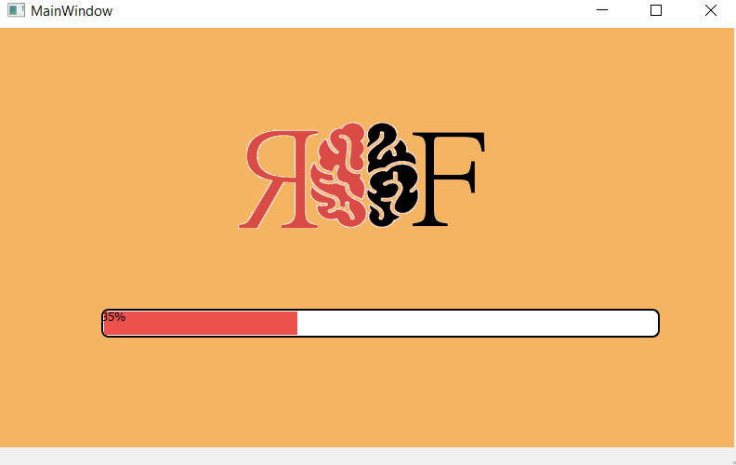
Progress bar:

Slide 4
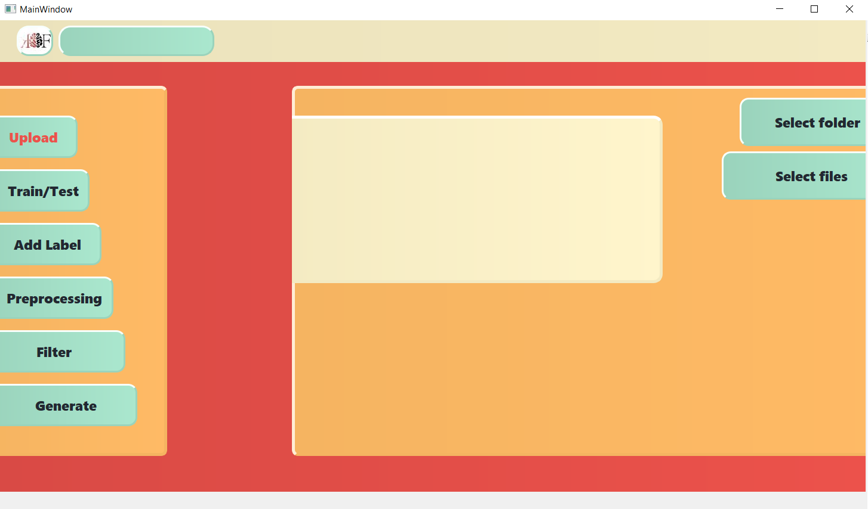
MainPage:

Slide 5
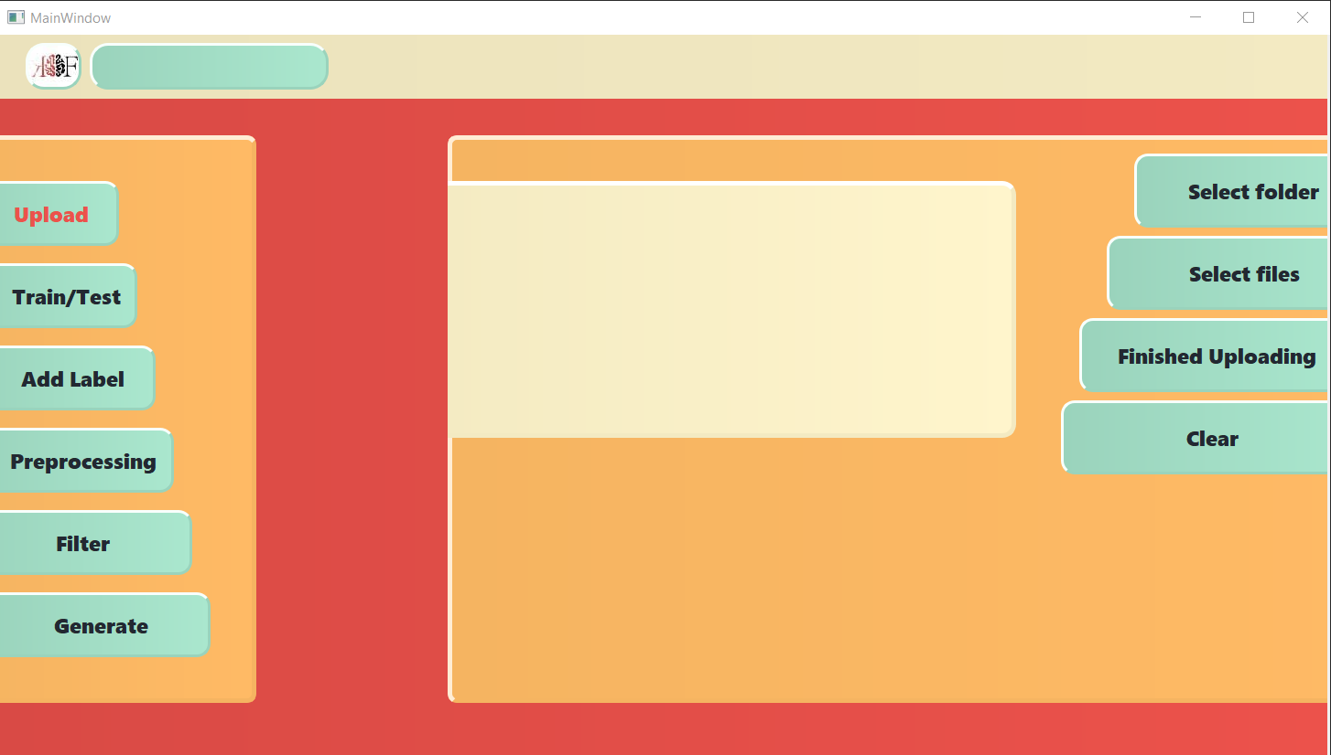
Selectfolder/Selectfile :

Slide 6
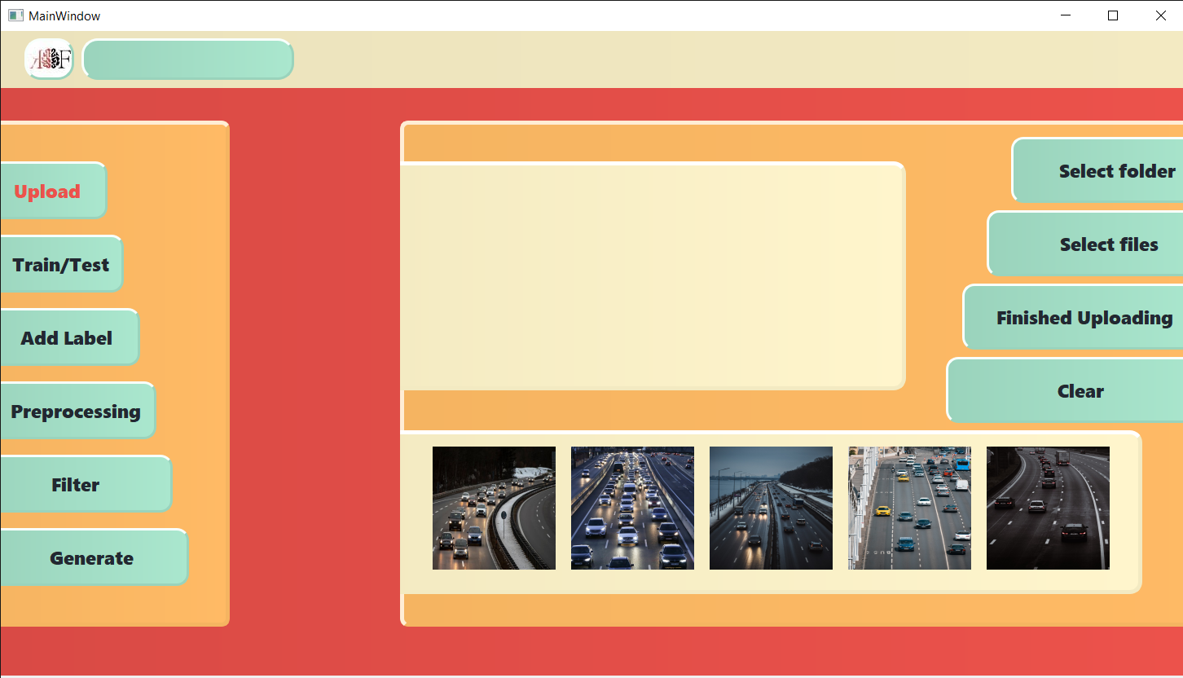
FinishedUploading :

Slide 7
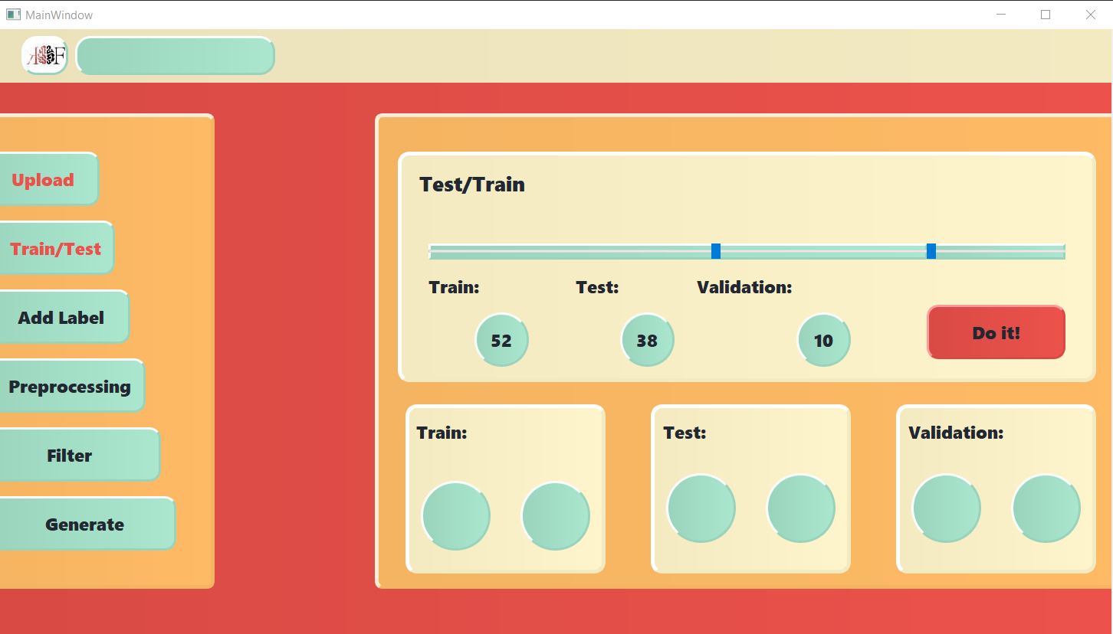
Train/Test :

Slide 8
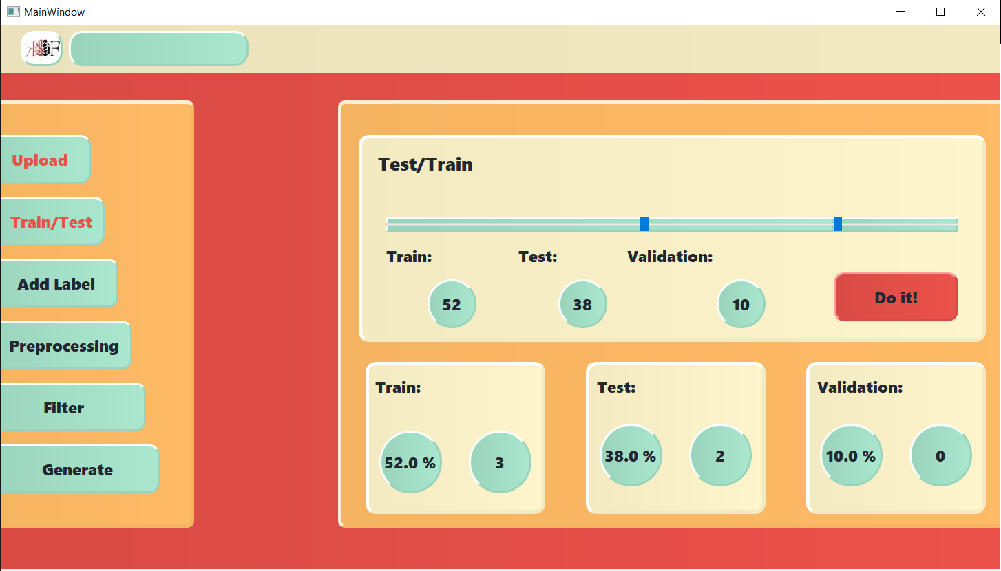
Do it! :

Slide 9
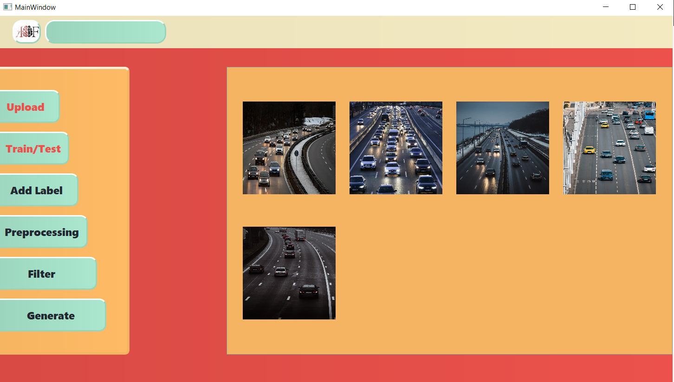
Add Label :

Slide 10
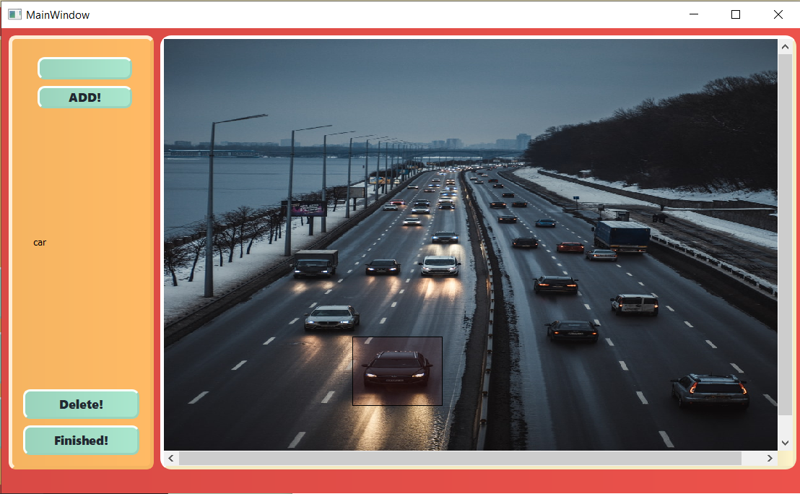
Add label :

Slide 11
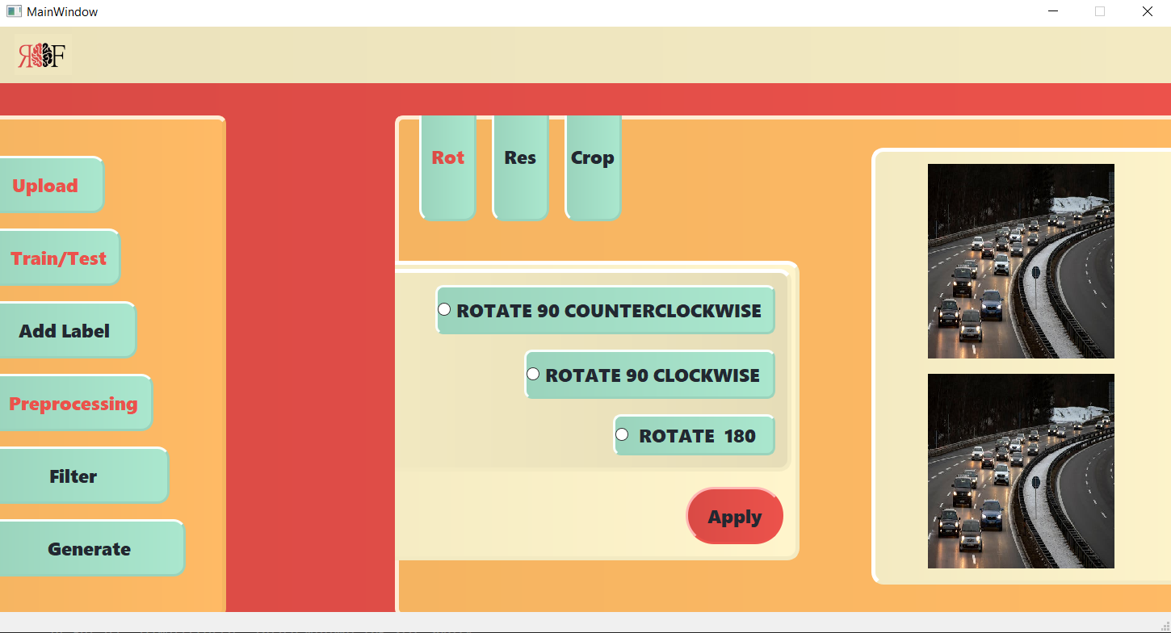
Preprocessing/rotate :

Slide 12
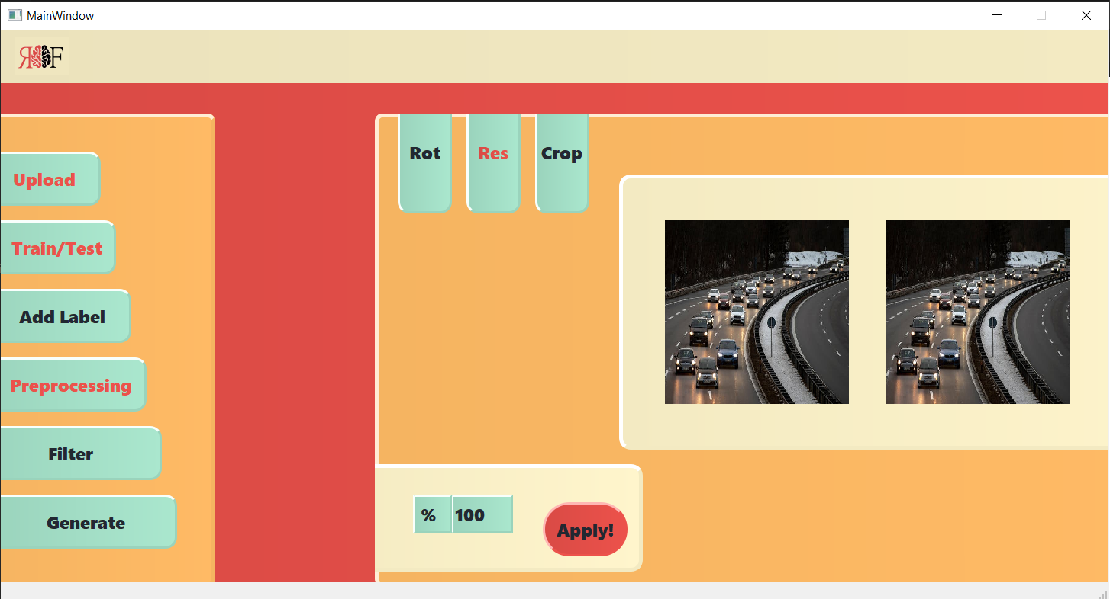
Preprocessing/resize :

Slide 13
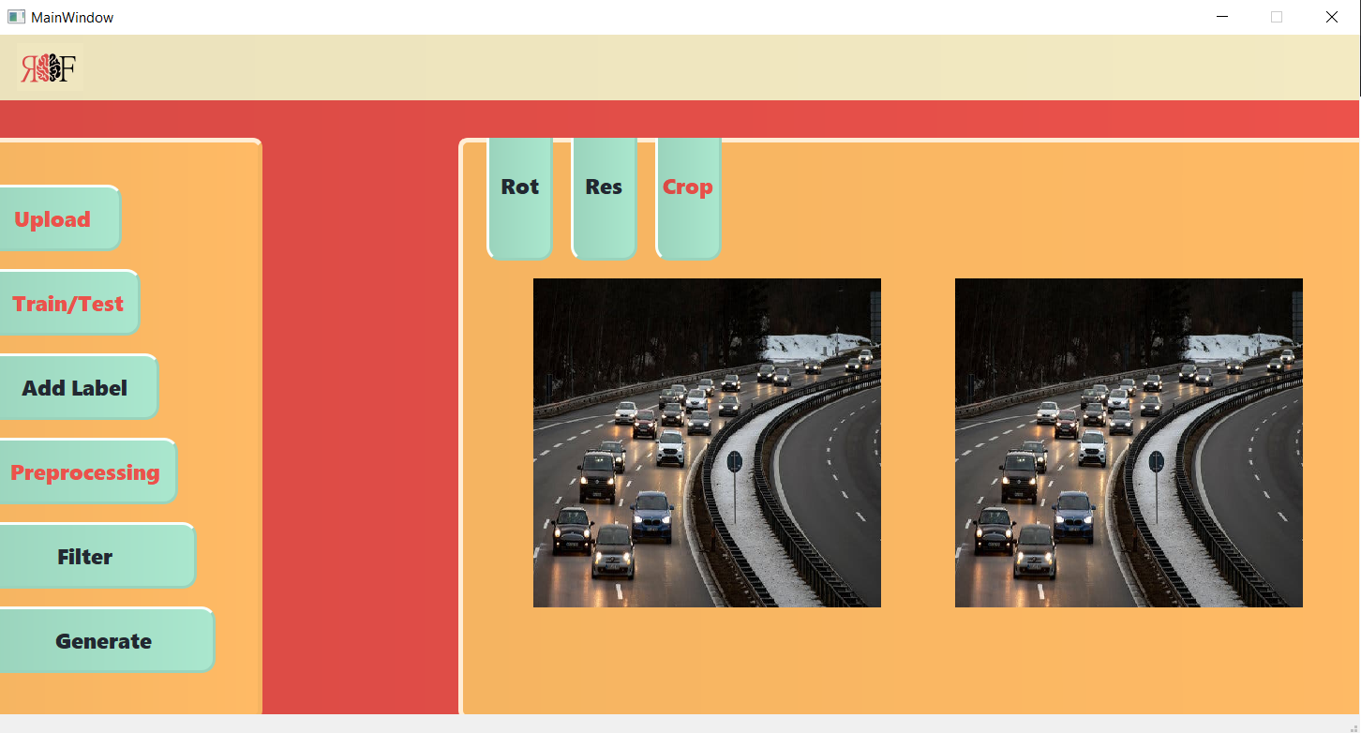
Preprocessing/crop :

Slide 14
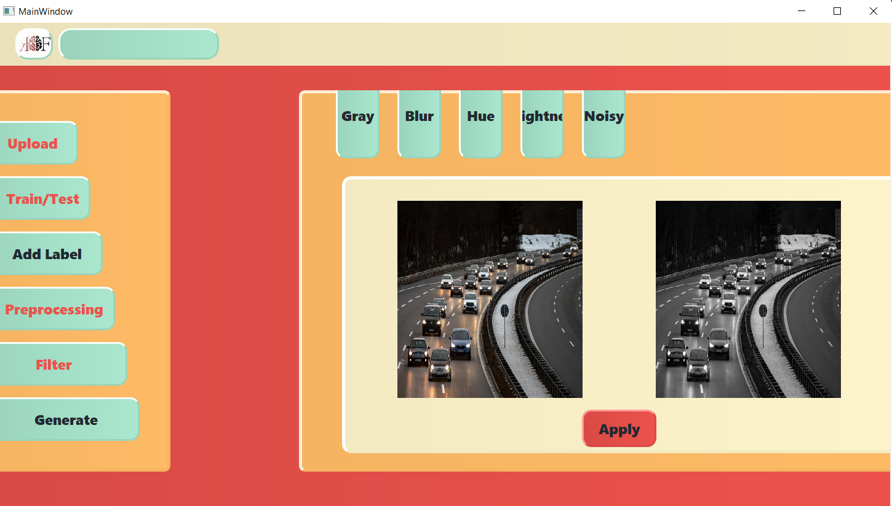
Gray :

Slide 15
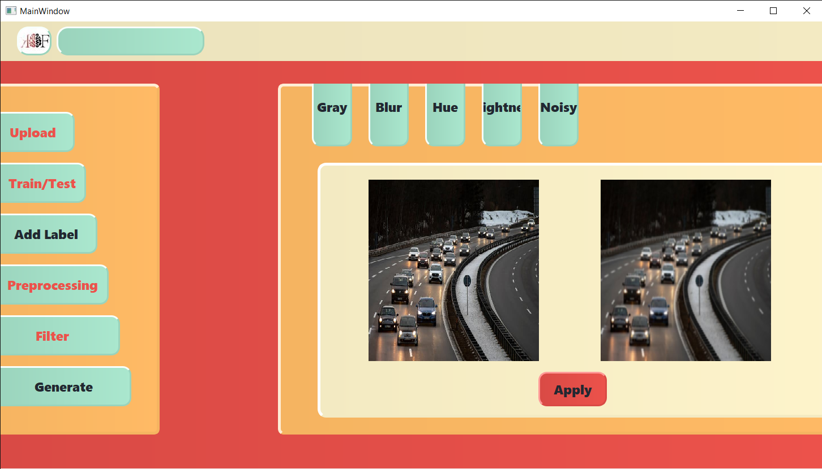
Blur :

Slide 16
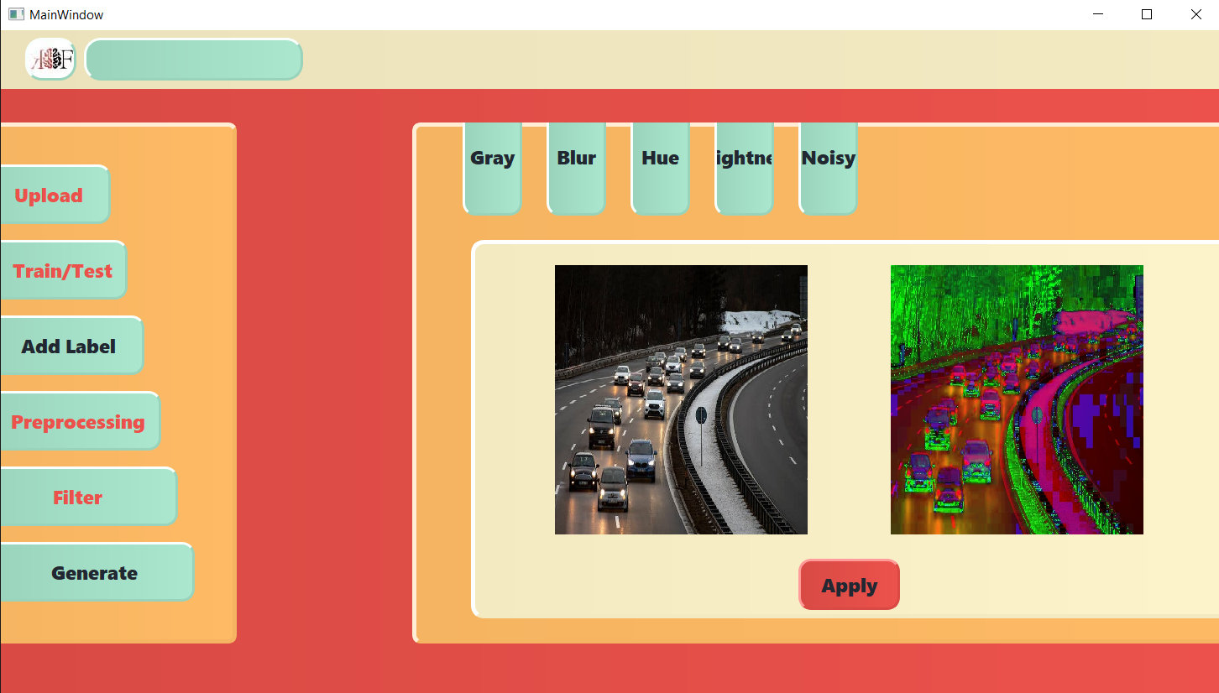
Hue :

Slide 17
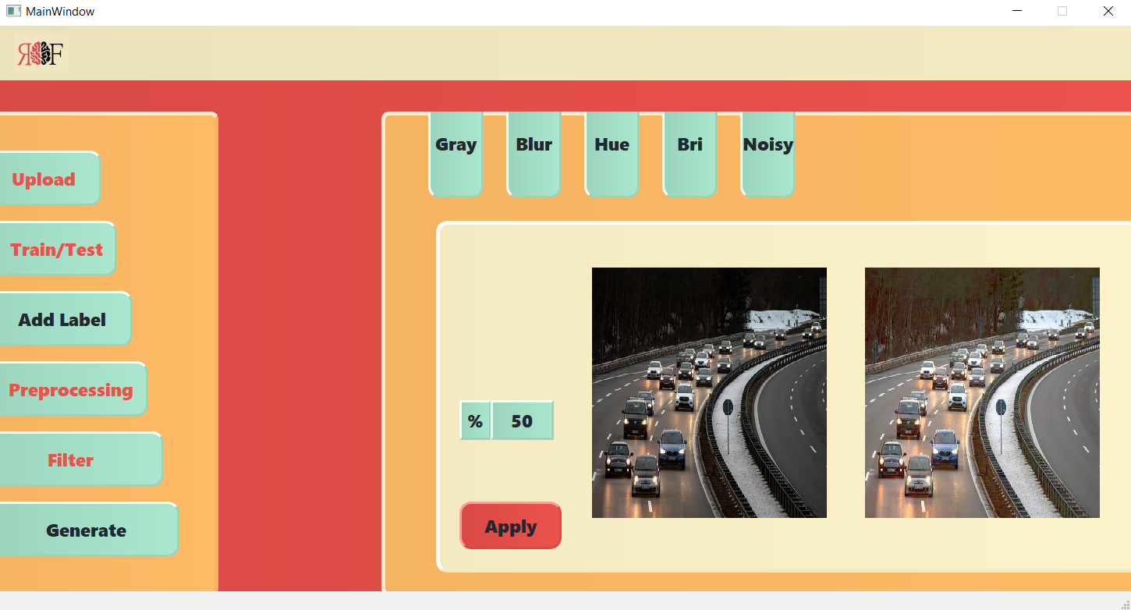
Brightness :

Slide 18
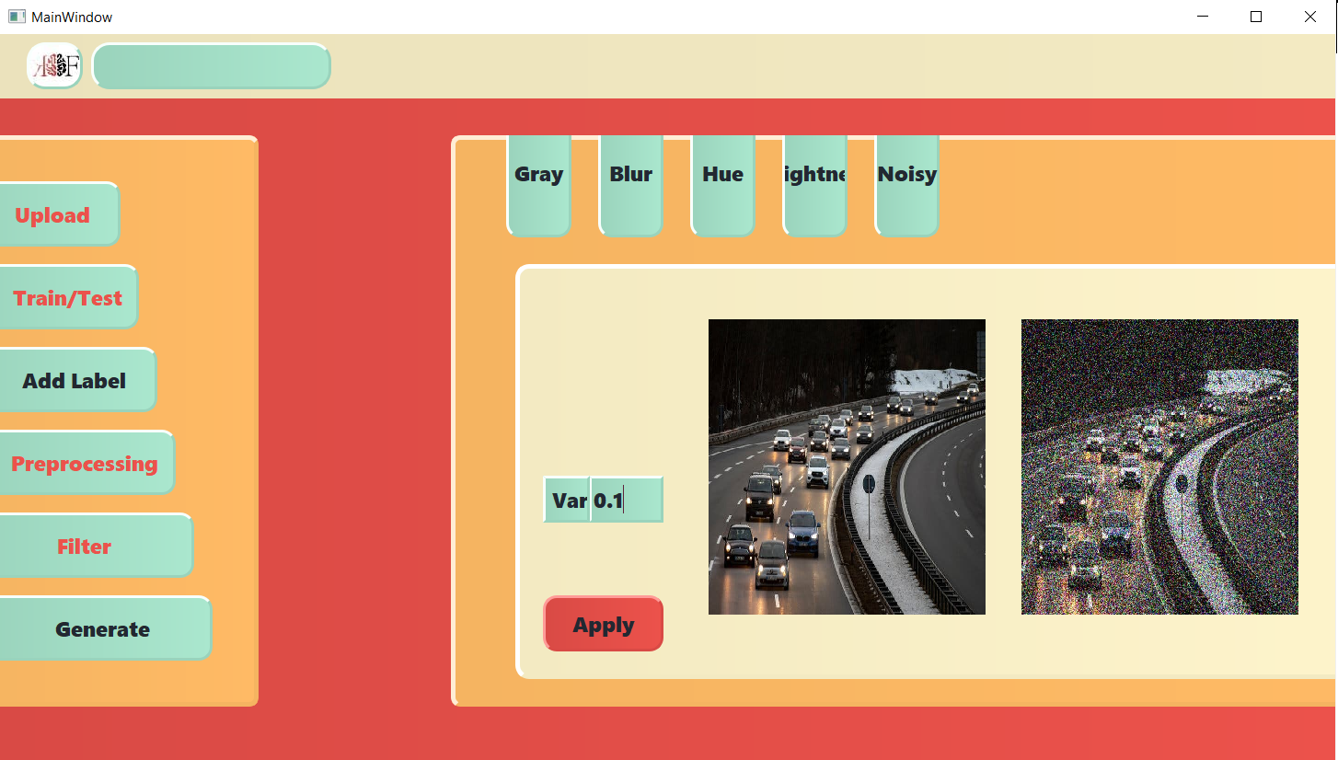
Noisy :

Slide 19
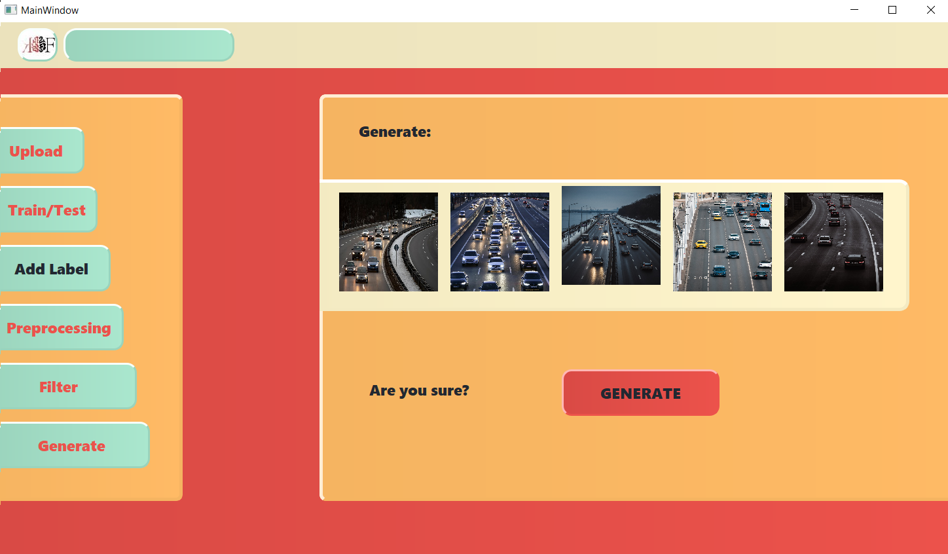
Generate :

